Slide 1

Spatial and temporal data management
Nothing puzzles me more than time and space; and yet nothing troubles me less, as I never think about them
Charles Lamb, 1810

Slide 2
Data management developments
Location-based services
Time-varying data

Slide 3
Spatial data
Managing spatially-referenced data
  Geographic information systems (GIS)
Theme
  The spatial counterpart of an entity
    River, road, scenic lookout
Map
  A theme represented on paper or a screen
Geographic object
  An instance of a theme

Slide 4
Generic spatial data types
Data type | Dimensions | Example
Point | 0 | Scenic lookout
Line | 1 | River
Region | 2 | County

Slide 5
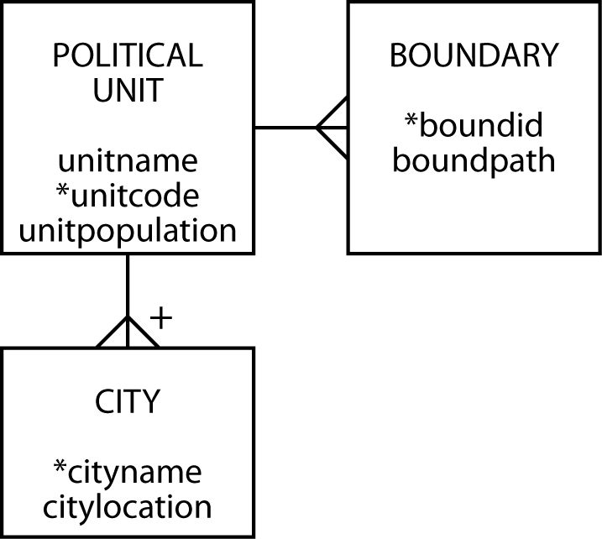
Data model for political units

Slide 6
PostgreSQL geometric data types
Geometric type | Representation | Description
BOX | ((x1,y1),(x2,y2)) | Rectangular box
CIRCLE | <(x,y),r> | Circle (center and radius)
LINE | ((x1,y1),(x2,y2)) | Infinite line
LSEG | ((x1,y1),(x2,y2))) | Finite line segment
PATH | [(x1,y1),…] | Closed path (similar to polygon)
POINT | (x,y) | Point in space
POLYGON | ((x1,y1),...) | Polygon (similar to closed path)

Slide 7
Create tables
CREATE TABLE political_unit (
unitname VARCHAR(30) NOT NULL,
unitcode CHAR(2),
unitpop DECIMAL(6,2),
PRIMARY KEY(unitcode));
CREATE TABLE boundary (
boundid INTEGER,
boundpath PATH NOT NULL,
unitcode CHAR(2),
PRIMARY KEY(boundid),
CONSTRAINT fk_boundary_polunit FOREIGN KEY(unitcode)
REFERENCES political_unit);
CREATE TABLE city (
cityname VARCHAR(30),
cityloc POINT NOT NULL,
unitcode CHAR(2),
PRIMARY KEY(unitcode,cityname),
CONSTRAINT fk_city_polunit FOREIGN KEY(unitcode)
REFERENCES political_unit);

Slide 8
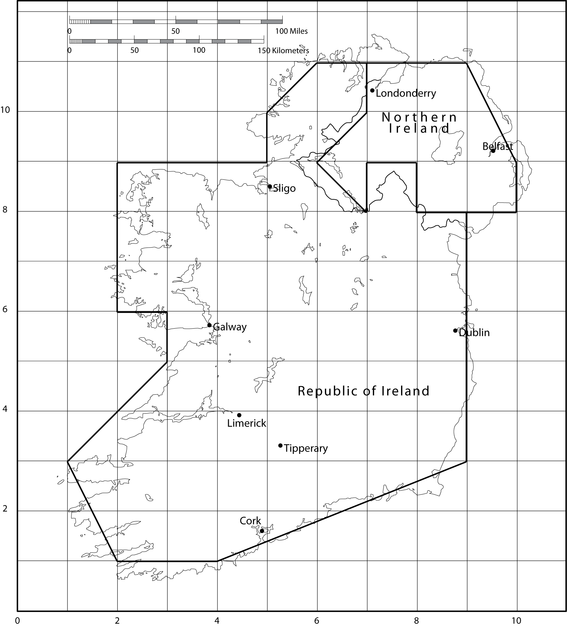

Slide 9
Insert rows
INSERT INTO political_unit VALUES ('Republic of Ireland','ie', 4.1);
INSERT INTO political_unit VALUES ('Northern Ireland','ni', 50.1);
INSERT INTO boundary VALUES
(1,'[(9,8),(9,3),(4,1),(2,2),(1,3),(3,5),(3,6),(2,6),
(2,9),(5,9),(5,10),(6,11),(7,11),(7,10),(6,9),(7,8),
(7,9),(8,9),(8,8),(9,8)]','ie');
INSERT INTO boundary VALUES
(2,'[(7,11),(9,11),(10,9),(10,8),(8,8),(8,9),(7,9),
(7,8),(6,9),(7,10),(7,11)]','ni');
INSERT INTO city VALUES ('Dublin','(9,6)','ie');
INSERT INTO city VALUES ('Cork','(5,2)','ie');
INSERT INTO city VALUES ('Limerick','(4,4)','ie');
INSERT INTO city VALUES ('Galway','(4,6)','ie');
INSERT INTO city VALUES ('Sligo','(5,8)','ie');
INSERT INTO city VALUES ('Tipperary','(5,3)','ie');
INSERT INTO city VALUES ('Belfast','(9,9)','ni');
INSERT INTO city VALUES ('Londonderry','(7,10)','ni');

Slide 10
Some PostgreSQL geometric functions
Function | Returns | Description
LENGTH(OBJECT) | double precision | length of item
NPOINTS(PATH) | integer | number of points

Slide 11
Some PostgreSQL geometric operators
Operator | Description
<-> | Distance between
<< | Left of?
<^ | Is below?
>> | Is right of?
>^ | Is above?

Slide 12
Length
What is the length of the Republic of Ireland’s border?
SELECT SUM(LENGTH((boundpath)))*37.5
AS "Border (kms)" from political_unit, boundary
WHERE unitname = 'Republic of Ireland'
AND political_unit.unitcode = boundary.unitcode;
Border(kms)
1353.99

Slide 13
Distance
How far, as the crow flies, is it from Sligo to Dublin?
SELECT (orig.cityloc<->dest.cityloc)*37.5 AS "Distance (kms)"
FROM city orig, city dest
WHERE orig.cityname = 'Sligo'
AND dest.cityname = 'Dublin';
Distance (kms)
167.71

Slide 14
Closest
What is the closest city to Limerick?
SELECT dest.cityname FROM city orig, city dest
WHERE orig.cityname = 'Limerick'
AND orig.cityloc <-> dest.cityloc =
(SELECT MIN(orig.cityloc <-> dest.cityloc) FROM city orig, city dest
WHERE orig.cityname = 'Limerick' AND dest.cityname <> 'Limerick');
cityname
Tipperary

Slide 15
Westernmost
What is the westernmost city in Ireland?
SELECT west.cityname FROM city west
WHERE NOT EXISTS
(SELECT * FROM city other WHERE other.cityloc << west.cityloc);
cityname
Limerick
Galway

Slide 16
R-tree
Used to store n-dimensional data (n>=2)
  Minimum bounding rectangle concept
A
D
C
B
E
X
Y
X
Y
I
n
d
e
x
s
e
t
A
B
C
D
E
S
e
q
u
e
n
c
e
s
e
t

Slide 17
R-tree searching
Search for the object covered by the shaded region
A
D
C
B
E
X
Y

Slide 18
Temporal data
Data have associated time
  When valid
  When stored
Different database states recorded
  Larger databases

Slide 19
Times
Transaction time
  Timestamp applied when data are entered
Valid time
  Time when value is valid or true

Slide 20
Times

Slide 21
Modeling temporal data

Slide 22
TSQL
Need additional features for
  Data definition
  Constraint specification
  Data manipulation
  Querying
TSQL (temporal structured query language) is designed to provide these features

Slide 23
Conclusions
The need to maintain spatial data will increase as location-based services become more common
Temporal data management will become more common so companies and customers have a complete historical record

